Slide 1

NIM GAME
Created by:
SOURAV CHAKRABORTY
ROLL:1607014
KU ET (Cse 16)

Slide 2
INTRODUCTION
Welcome to my project based on nim game. I use object oriented
Programming in C++ language to make this project .
Nim game is commonly used as game theory problems . We find this type of problems not only in programming contest but also in our real life.

Slide 3
Rules for Nim
This is a two player game in which each player takes turn picking stones from a pile.
On each turn, the player has the choice of taking any number of stones, so long as you only take from one pile.
Each player must take at least one stone each turn.
The player taking the last stone on the board wins!

Slide 4
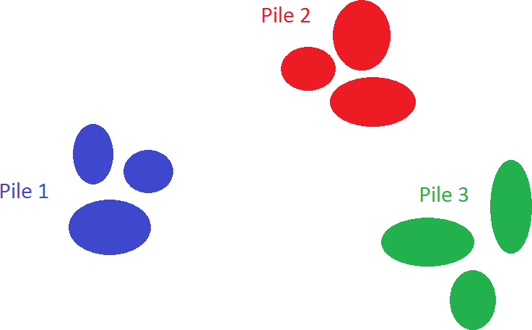
How the game would look…

Slide 5
Player 1 starts

Slide 6
Player 2
Empty!!!

Slide 7
Player 1
Empty!!!

Slide 8
Player 2
Empty!!!

Slide 9
Player 1
Empty!!!
Empty!!!
Empty!!!

Slide 10

Player 1 Wins!!!
Empty!!!
Empty!!!
Empty!!!

Slide 11


Sounds Interesting!!!

Slide 12
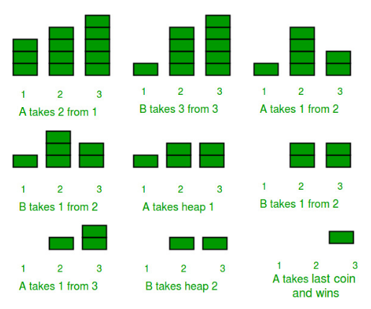
Let’s take another example
Consider that there are two players- A and B, and initially there are three piles of coins initially having 3, 4, 5 coins in each of them as shown below. We assume that first move is made by A. See the below figure for clear understanding of the whole game play.

Slide 13


SIMPLE,ISN’T IT?

Slide 14
Game Approach
First step was simply getting the computer to play the game of Nim by itself
Secondly, I made a human player be able to play with the computer or another player , and I added the rules of the game into the code.

Slide 15
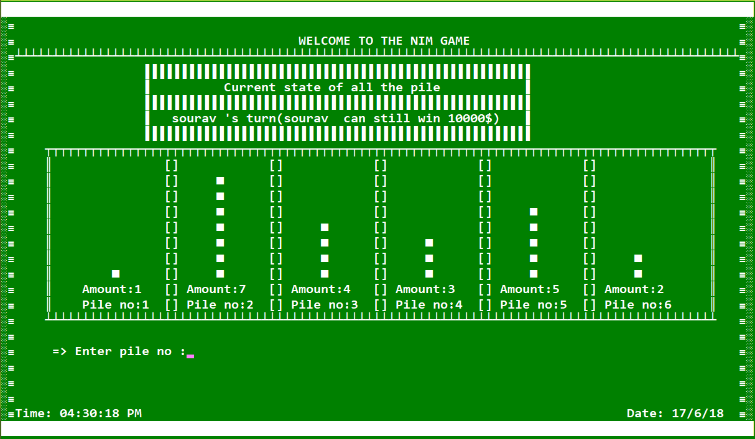
GAME DISPLAY

Slide 16
Use below things in my project
Class, Object, Member function, Non member function, Friend function, Getter function, Setter function, Operator overloading, Constructor, Destructor, Copy constructor(deep copy, shallow copy), Pointer in Function and Class, Cascading, Dynamic memory allocation, Functors, Lambda, File for take (I/O), Format printing, Inheritance, Polymorphism, Template, Stl, Namespace, This Pointer, Basic use of Graphics in C++ and Many more.

Slide 17
Project Description In a nutshell
# Inheritance & Polymorphism : Used Multiple inheritance it’s allow a child class to inherit from more than one parent class.
# Dynamic memory allocation : Using it for taking name
# Operator Overloading : Overloaded [ ] - << operator.
# getline() after cin: Using it before taking name
# Template : Use it for doing multiple type of work in a same class.
# STL : Use vector and stack to build up leaderboard.

Slide 18



Slide 19



